Slide 1
Financial Statement Evaluation

Slide 2
Financial Statement evaluation
  Analysis involves highlighting relationships between items in the financial statements in order to enhance understanding
  Interpretation involves explaining relationships to provide users with information to take action
  May use trends for prediction
  (Source: Wells & Dixon)

Slide 3
The information needs of the various users
Besides Managers who is interested in FSE?
  Investor groups
  Lenders
  Competitors
  Employees

Slide 4
Tools - Horizontal Analysis
Change in $$s line by line
Change in % terms (Use prior year as base)
Example – Sales % increase (Ratio 13)
  Sales in 2019 = $880,000, 2018 =$670,000
  Change* 210,000/670,000 * 100 = 31.3%
  (Change = 880,000-670,000 = 210,000)

Slide 5
Tools - Vertical Analysis (Common Size)
Use one significant figure as the base and express other items in the Statement as a percentage of that base figure
Income Statement – usually Total Sales
Balance Sheet – usually Total Assets
An example you have already encountered is the Gross Profit Percentage
  Gross profit = $440,000 and Sales = $880,000
  440/880*100 =50%

Slide 6
Financial Ratios
Ratios provide a quick and simple means of examining the financial health of a business
A ratio simply expresses the relationship between one figure appearing in the financial statements with another e.g. net profit in relation to owners funds invested in the business
Ratios are simple enough to calculate, and a good picture can be built up with just a few. However ratios can be difficult to interpret
Ratios can be expressed in various forms e.g. percentages, fractions or proportions, depending on the use of the information

Slide 7
Ratio Forms
Ratios: relationship e.g. 2 for 1 sponsorship. Written 2:1 or just 2
Percentage rate e.g. 9.5 percent interest. Written: 9.5%
Rate e.g. new building is five times higher. Written 5x
Charts –refer next slide

Slide 8
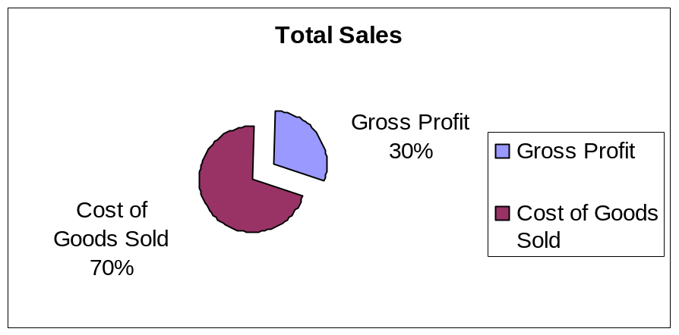
Charts
PIE CHART
Sales
$s
TREND
1 2 3 4 5 6 7 8
Years

Slide 9
Uses of ratio analysis
overcomes the difficulties in comparing entities of different sizes
aggregates similar items into meaningful groups
highlights significant relationships

Slide 10
Uses of ratio analysis
analyses information from different statements
highlights anomalies
serves as an independent variable in models for external evaluations
serves as indicator or measurement tool in contracts

Slide 11
Averages
Earning profit, generating cash flow etc are processes which occur over a period, not at a point in time.
To account for this, averages are used extensively in Financial Statement evalutation. E.g. In Return on OE and Total Assets, Accounts Receivable and Inventory turnover
In each case the average = (Opening + Closing)/2
When looking for the numbers remember that the previous period’s closing is the current period’s opening

Slide 12
The need for comparison
Comparability is an enhancing qualitative characteristic (the New Zealand Framework)
A calculated ratio on its own does not say much about a business - it is only when it is compared with some form of ‘benchmark’ that the information can be interpreted and evaluated

Slide 13
The Need for Comparison
Bases (benchmarks) that may be used as a basis of comparison for ratio analysis include:
  ‘Intertemporal’ - Based on past performance. Compare this period with previous periods
  Budget - Based on planned performance
  Intra-industry - Based on comparison of performance with other firms in the same industry
    Compare this entity and other entities
    Compare this entity with industry averages
    (Source: Atrill et al)

Slide 14
Comparison of Ratios
Between time periods
  NZIAS 1 requires disclosure of previous period
  Trend analysis is a comparison over several years, often disclosed in an annual report
Between firms
With industry averages
Comparison
  reveals strengths and weaknesses
  identifies problems
  raises questions for further investigation

Slide 15
Financial Ratio Classification
Refer to list “Evaluation ratios for use with Cunningham”
Profitability - Measure of success in wealth creation
Operating Capability – ability to sustain a given level of operations. Also reveal the effectiveness of utilisation of resources
Liquidity - The ability to meet short-term obligations
Gearing - Measure of degree of risk associated with the amount of leverage used to finance the business

Slide 16
Analysis Ratios for use with Cunningham (Ccpy on stream and p.3 of Acme)
 | TYPE OF RATIO
 | PROFITABILITY
1 | Profit Margin | Net Income x 100 Net Sales
2 | Gross Profit Percentage | Gross Profit x 100 Net Sales
3 | Return on Total Assets | (Net Income + Interest Expense) x 100 Average Total Assets
4 | Return on Owner’s Equity | Net Income x 100 Average Owner’s Equity
 | EFFICIENCY
5 | Inventory Turnover | Cost of Goods Sold Average Inventory
6 | Number of Days in Selling Period | ______365_________ Inventory Turnover
7 | Accounts Receivable Turnover | Net Credit Sales Average Accounts Receivable
8 | Number of Days in Collection Period | 365 Accounts Receivable Turnover
 | LIQUIDITY
9 | Current Ratio | Current Assets Current Liabilities
10 | Quick Ratio | Quick Assets Current Liabilities Where Quick Assets = Cash + Accounts Receivable + Short Term Marketable Securities + Short Term Notes Receivable
 | FINANCIAL GEARING
11 | Debt Ratio | Total Liabilities x 100 Total Assets
12 | Interest Coverage | Net Income + Interest Expense Interest Expense
 | OTHER
13 | Sales % Increase | (Sales Year 2 – Sales Year 1) x 100 Sales Year 1

Slide 17
8.3 Evaluating liquidity
Liquidity is a measure of how quickly a business can convert its assets into cash to pay its bills.
External users assess how well a business manages its liquidity by studying its working capital (CA-CL).
In week 5 the current ratio and the quick (acid-test) ratio were introduced. They are two common indicators of a business’ liquidity.
Current ratio –shows the ability of the business to pay debts in the ordinary course of business
Quick ratio – shows the ability of the business to pay debts when put under pressure to do so

Slide 18
Evaluating financial flexibility
Financial flexibility is the ability of a business to adapt to change.
Managers, owners and creditors are also interested in a business’ ability to take advantage of major, long-term business opportunities. E.g. ability to borrow more to finance a business opportunity.
To assess long-term financial flexibility, financial statement users calculate a business’ debt ratio. If the debt ratio is too high banks won’t lend

Slide 19
Evaluating profitability
Decision makers use profitability ratios to evaluate how well a business has met its profit objectives in relation to the resources invested.
Profitability ratios include
  The profit margin From each dollar of sales, what is left over for the owner. Shows the impact of overhead expenses (Week 6)
  The gross profit percentage. How well the business traded and what is left over to cover overheads and profit (Week 6)
  the return on total assets ratio. How well resources are used. Return on OE is profit. Return on L is interest. Therefore return on A = Profit + interest.
  the return on owner’s equity ratio. How much the owner’s investment in the business earns

Slide 20
Evaluating operating capability
-efficiency
Operating capability refers to a business’ ability to sustain a given level of operations.
Information about a business’ operating capability helps in evaluating how well it is maintaining its operating level, and in predicting future changes in its operating activity.
Two common activity ratios are inventory turnover and accounts receivable turnover.
It is critical to turn Inventory and Receivables into cash as quickly as possible to enable payment of creditors and/or to purchase non current assets.

Slide 21
Coffee Supreme
INCOME STATEMENT FOR THE YEAR ENDING 31 MARCH
 | 2019 | 2018
Sales (on credit) | 116,800 | 100,000
Opening Inventory | 20,000 | 2,000
Add Purchases | 131,000 | 98,300
Cost of Goods Available for Resale | 151,000 | 100,300
Less Closing Inventory | 56,000 | 20,000
Cost of Sales | 95,000 | 80,300
Gross Profit | 21,800 | 19,700

Slide 22
INVENTORY TURNOVER
= Cost of Goods Sold/ Average Inventory
 | 2019 | 2018 | 2017
Cost of Goods Sold | 95,000 | 80,300
Inventory | 56,000 | 20,000 | 2,000
Average Inventory | (56,000+20,000)/2 = 38,000 | (20,000+2,000)/2= 11,000
Inventory Turnover | 95,000/38000= 2.5x | 80,300/11,000 =7.3
Days in Selling Period | 365/2.5= 146 | 365/7.3= 50

Slide 23
What does Inventory Turnover tell us?
How quickly coffee is coming in and leaving the business
The time taken from receiving goods to selling them
For Coffee Supreme this has lengthened from 50 days to 146 days which is not a positive trend
Risks and Costs
  Stock deterioration and theft
  Costs of storage
  Opportunity cost of money tied up in inventory

Slide 24
Coffee Supreme
RECEIVABLES TURNOVER = Net Credit Sales/ Average Receivables
 | 2019 | 2018 | 2017
Sales (all on credit) | 116,800 | 100,000
Accounts Receivable | 44,000 | 20,000 | 20,000
Average Receivable | (44,000 + 20,000)/2 = 32,000 | (20,000 + 20,000) / 2 = 20,000
Receivables Turnover | 116,800/32,000= 3.65x | 10,000/20,000 = 5
Days in Collection Period | 365/3.65 = 100 | 365/5 = 73

Slide 25
What does Accounts Receivables turnover tell us?
How long credit customers are taking to pay
How effective the credit policy of the business is
Risks and costs
  Business may be late in paying its Accounts Payable and therefore get a bad name with suppliers
  Some customers may never pay – bad debts
  Opportunity cost of cash not received on time
Coffee Supreme customers are taking 27 days longer to pay in 2019. This is not good. Need to know the credit terms but even 73 is a lot longer than usual 35 days (20th month following)

Slide 26
8.5 Limitations of the income statement and the balance sheet
The income statement and the balance sheet do not provide much information about a business’ cash management because they are based on accrual accounting.
The statement of cash flows is needed as an additional financial statement.

